Slide 1
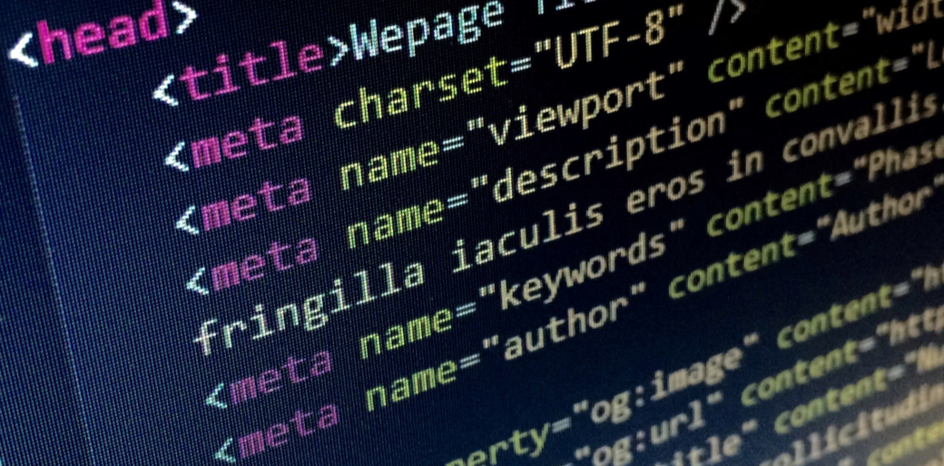
Personal Photography Portfolio Site
- By Jen Kettle P2714765
1 of 20

Slide 2
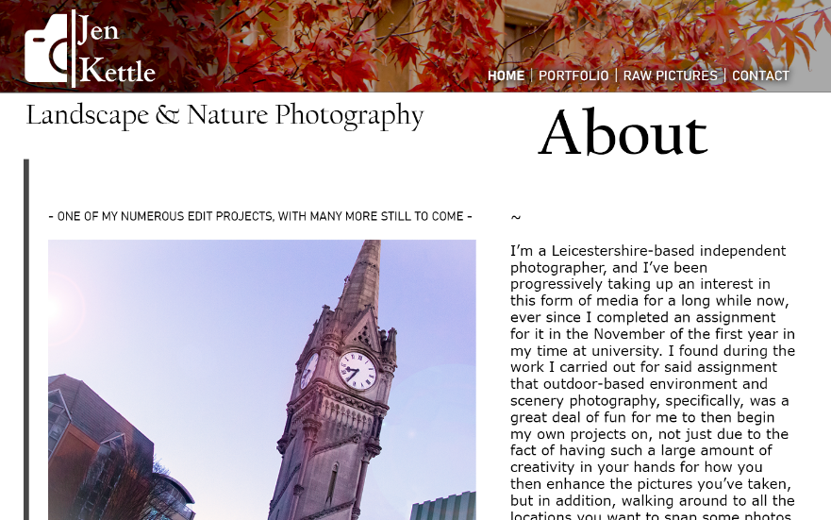
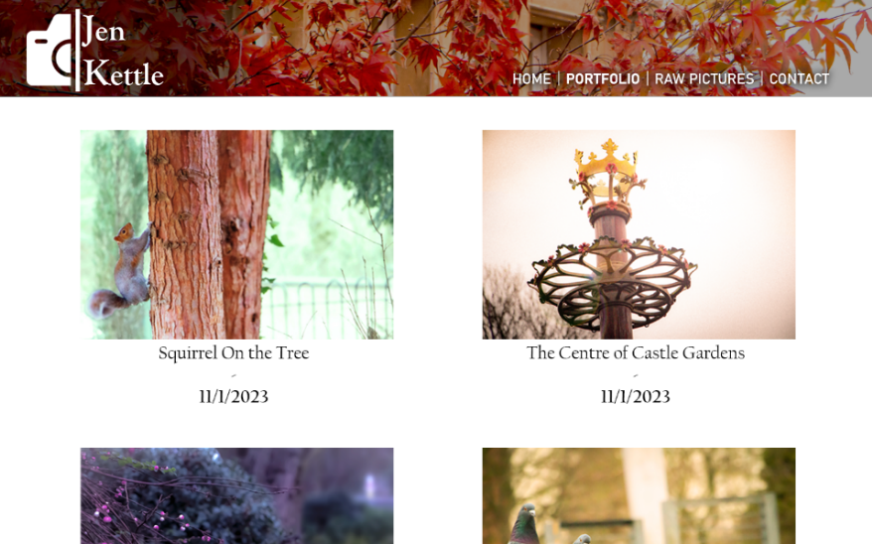
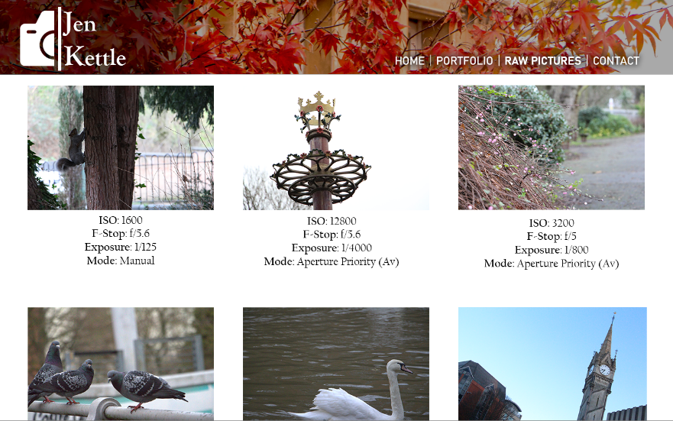
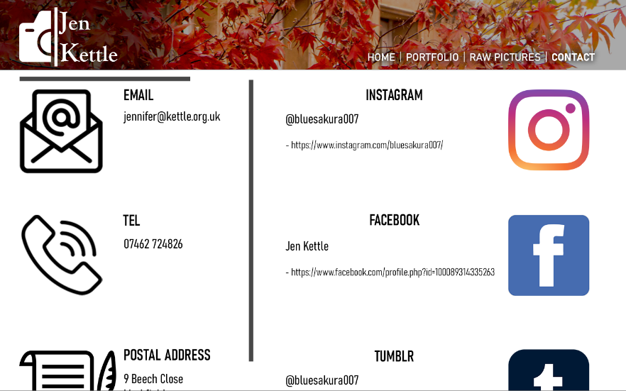
Chosen concept – similar to the web pages I designed in the previous half of the module taught by Jonny Dutra, so I’m now making that somewhat of a reality
2 of 20

Slide 3
Similarities to the Original Photoshop Design Concept
Same header bar image
Similar thin, elegant-looking font and the same colour for the name text within said header bar
Same planned Home page written sentences from the main text body
Photography works shown on the Portfolio page set to be displayed in equal rows of two each
Involves the displaying of the technical specifications of the camera when the photographs were taken
Same social media links and other means of contact listed
3 of 20

Slide 4
Differences
In this case, the name text in the header bar glows
There isn’t an area of shadow behind said name text
A video link is included on the Home page, with a golden tilde symbol on either side for decorative purposes
The image shown on Home isn’t an example of one of my photographic works but in this case is instead an avatar image of myself, with a rounded border
The contact links and details aren’t listed as the content of one specific page, and are shown in a column down the bottoms of both of the programmed pages as a footnote
The navigation bar is shown as its own quasi-section beneath the header bar and tagline rather than being another part of said header area, with no drop shadow underneath the text links to the two pages
The technical specifications and details of each photograph are displayed as features to be found when the photos are clicked on, instead of these details being on their own page
4 of 20

Slide 5
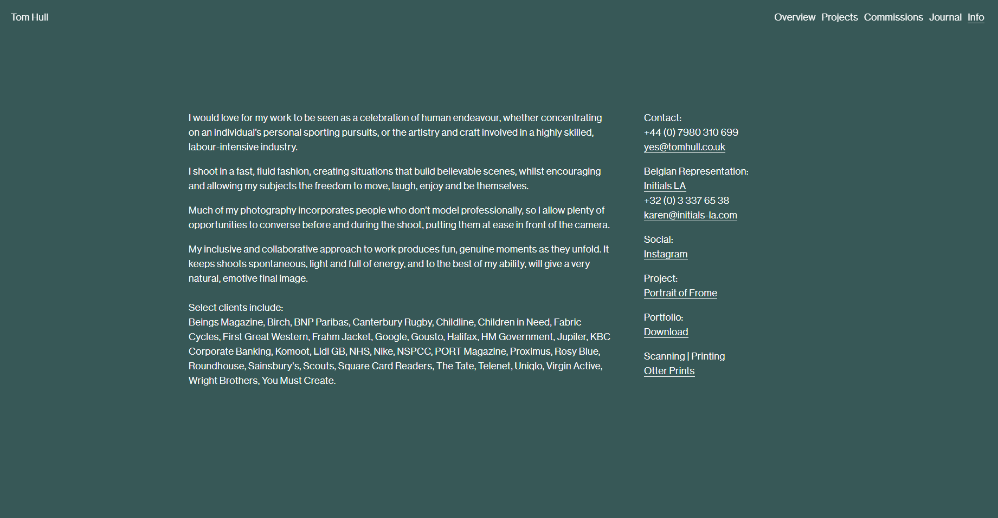
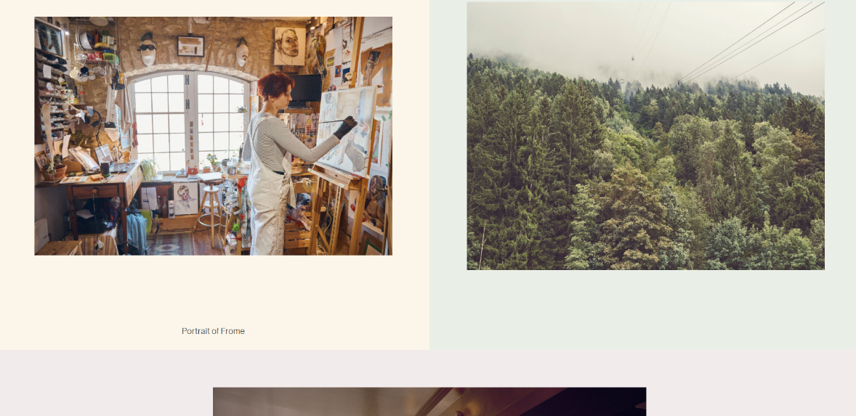
Inspiration Site 1/3: Tom Hull
This was the website which inspired my design concept for the previous half of the module in the first place, and thus my HTML/CSS-coded site in this half is a further improvement measure of sorts upon it.
The neat and sleek-looking organization of his own website’s Info (left) and Projects pages pictured above is something that I like, although while I was writing out the programming for mine when it was still being developed, the large amounts of empty space on Info around the text paragraphs were something that I hoped to avoid, and so was the bland, plain appearance of the header bar shown at the top of every page, with text elements that are too small and definitely not as eye-catching as they should’ve been.
5 of 20

Slide 6
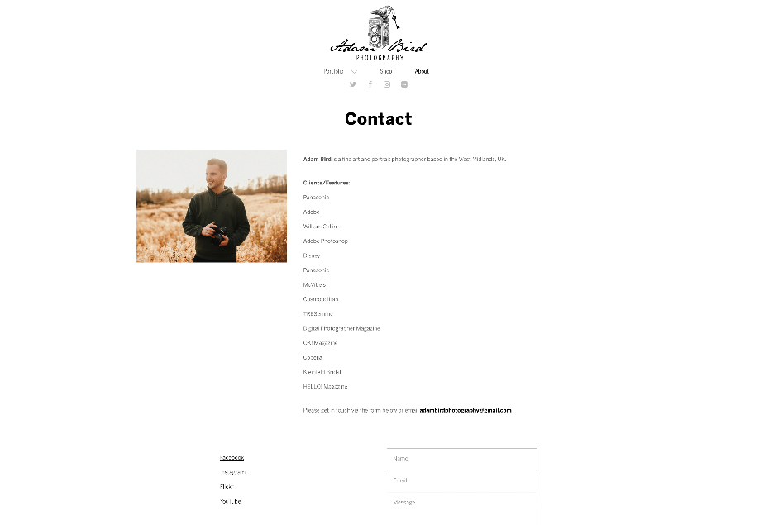
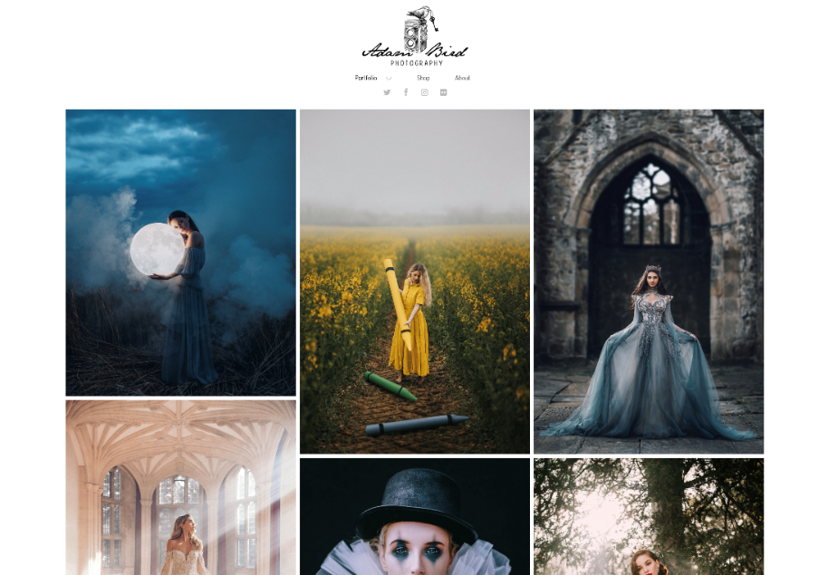
Inspiration Site 2/3: Adam Bird
This is another photographer website I found which had an appealing general appearance due to its neatness, and though I wasn’t entirely able to understand how to arrange the photographs on my Portfolio page in the same somewhat uneven manner via my HTML and/or CSS code, this was another aspect of Adam Bird’s site that I found to add to this appeal in its look.
However, although the header bar constant for all pages is more eye-catching than Tom Hull’s and the content on this site’s About page is also arranged neatly, the latter – not unlike the text shown on Tom Hull’s Info page – also seems to have a lot of empty white space around it, making this particular page look rather barren.
6 of 20

Slide 7
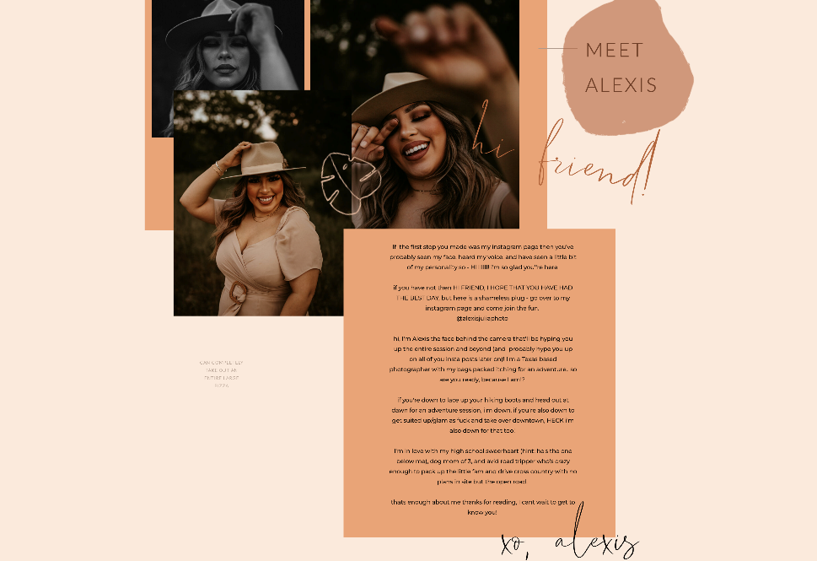
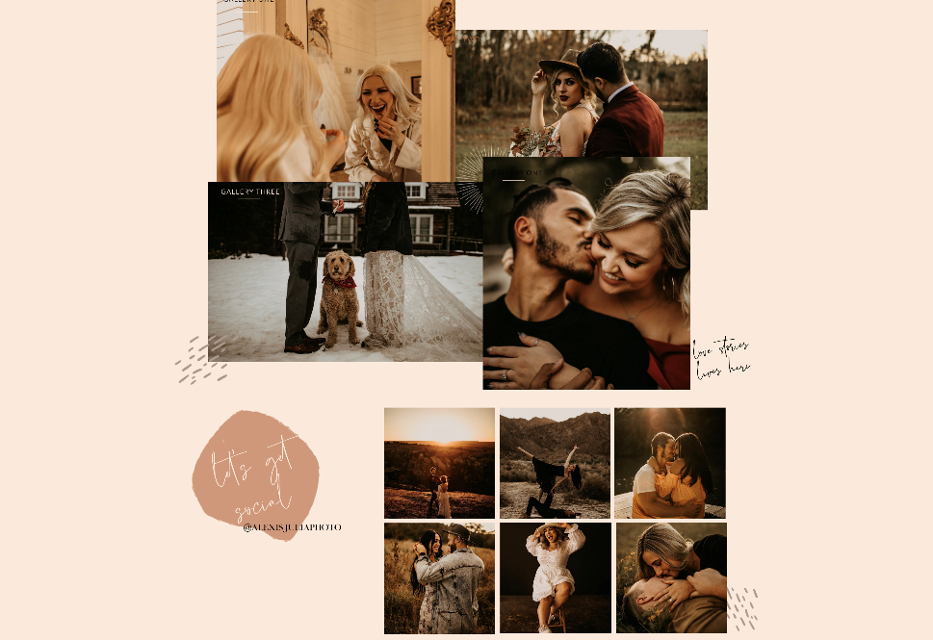
Inspiration Site 3/3: Alexis Julia
Finally, in the case of the website of Alexis Julia as another of my inspiration sources for my own site, in comparison to the previous two displayed examples the content on hers, both in image and text form, appears to have more of a disjointed look, with some elements even overlapping. This is another technique that during my site’s development I didn’t entirely know how to implement myself in the programming, but nonetheless I did think this finding was an appealing trait of Alexis Julia’s pages. Furthermore, I also quite liked how for the most part she’s avoided having empty, barren space around her shown elements, and the warm but not glaring colour tone which she’s used for the website as a whole is something I’ve decided to make use of for mine.
7 of 20

Slide 8
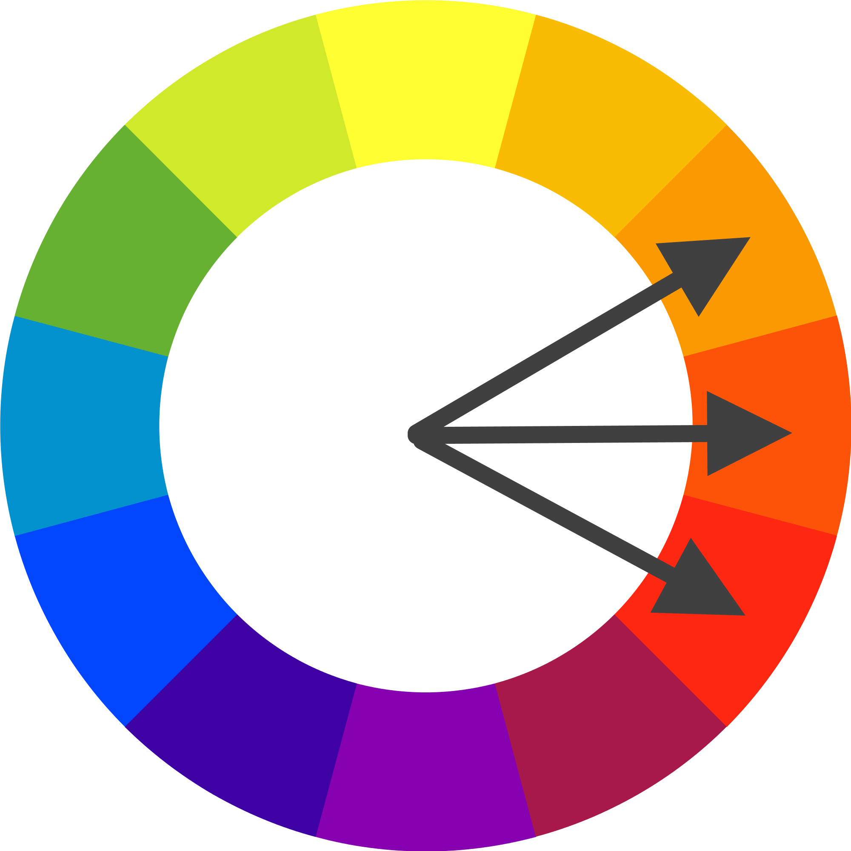
Warm (reds and oranges, with some yellow): Main scheme, colours of header bar which is on both pages
Cool (blues): Some comparatively smaller elements that are different on the two pages – the avatar image on Home and some of the photographs presented on Portfolio
Overall, the colours that I’ve decided on using for my website are a somewhat analogous scheme, which is also the same way in which I designed the original concept’s own palettes.
8 of 20

Slide 9


Although the content that’s the main focus of the Home page on my site is the text paragraphs containing the written introduction of myself and said website, I came to the decision while coding developments were underway that immediately above them will lie the video link that I planned to also include on this same page, this video being one containing various video shots that were filmed and edited together a few months ago, as a class exercise back in October. The inclusion of the video was done to fill more of the space on Home’s background by adding another element instead of the page just focusing on my introduction and avatar image, as well as setting more of the feel of what the website’s all about, and the gold-coloured tildes on either side of it are ones that I created in Photoshop, for decorational purposes to further fill more of the page background space.
The header bar, which is a design aspect primarily coded within a CSS file due to it being on both pages
The golden tilde symbols presented on either side of the video link, with both of these different types of elements being exclusive to the Home page unlike the header shown above
9 of 20

Slide 10
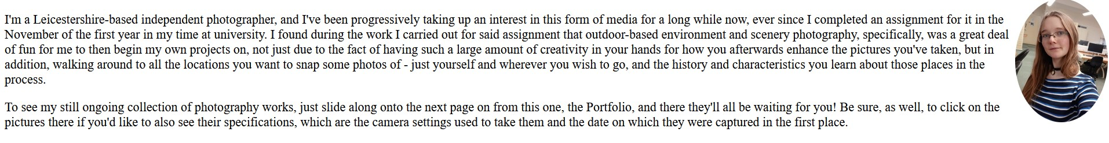
The previously-mentioned main paragraphs and accompanying avatar image on Home
I decided that I’d have these two complete paragraphs in a font which wasn’t that small, to avoid the emptiness around them which I found to have occurred on Tom Hull’s Info page, predominantly caused by his choice of having written its own paragraphs of text in quite a small size by comparison. Also, like what had been done for Adam Bird’s site’s About page, meanwhile, I thought that it was best to keep my writing in black over a white page background, to keep the text content easy to read and therefore maintain the professional look that I’m aiming to achieve through my site’s programmed design.
10 of 20

Slide 11
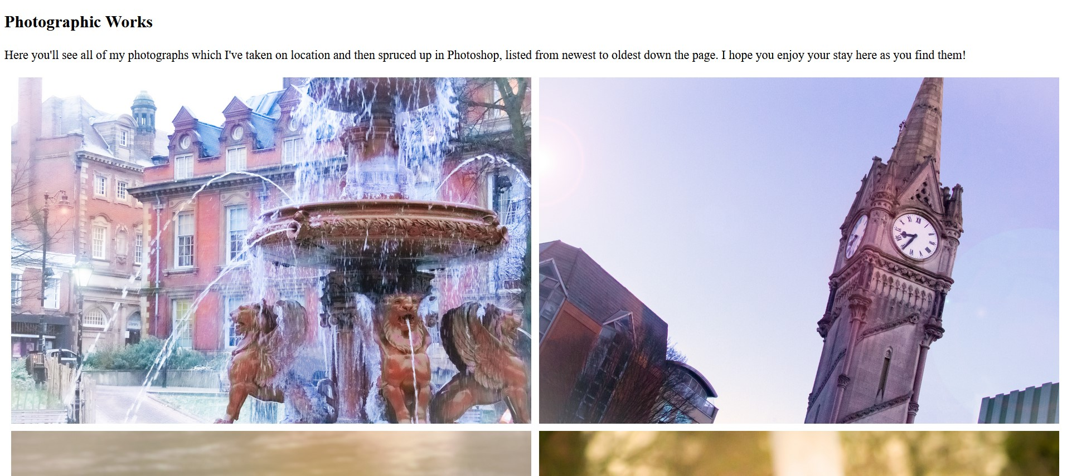
As shown below, for the other page, Portfolio, I adhered to my plan for an overall analogous colour scheme for my site; the latest two of the photographs presented on this page happen to both have cool tones of varying shades of blue and violet, so I made the decision to show the images down the page in the order of newest to oldest for two reasons: another way of making my design concept from a few weeks ago come true, and to serve as a contrast – though not too glaring or obvious – to the warm, mostly orange tones of the header bar displayed for the whole site. For a time, these photographs were originally packed together with their edges touching, until I decided to program in white borders to match the page background, to make their arrangements against each other neater and more streamlined.
The start of the main content area of the Portfolio page
11 of 20

Slide 12

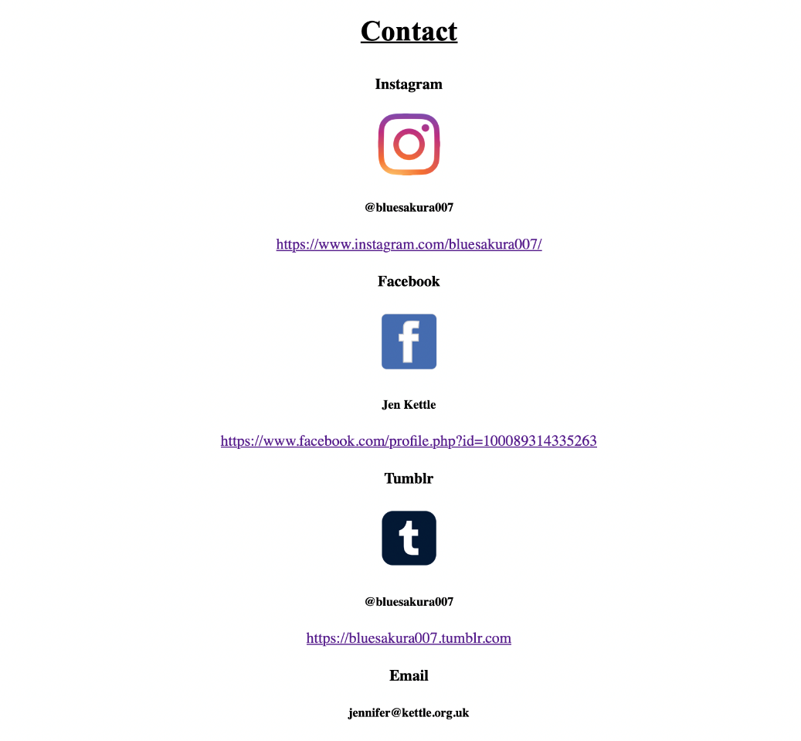
The tagline and navigation bar for my website as a whole – these are both more elements shown on both pages as a constant, like the header section
As shown below, for the other page, Portfolio, I adhered to my plan for an overall analogous colour scheme for my site; the latest two of the photographs presented on this page happen to both have cool tones of varying shades of blue and violet, so I made the decision to show the images down the page in the order of newest to oldest for two reasons: another way of making my design concept from a few weeks ago come true, and to serve as a contrast – though not too glaring or obvious – to the warm, mostly orange tones of the header bar displayed for the whole site. For a time, these photographs were originally packed together with their edges touching, until I decided to program in white borders to match the page background, to make their arrangements against each other neater and more streamlined.
Another section of content programmed and designed for both pages: the Contact area
12 of 20

Slide 13
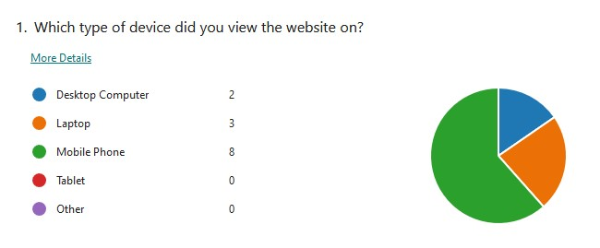
I created and sent out a user feedback survey for my programmed website to the members of my friend circle, my parents and uncle and various other people once my website was still as of then uncompleted but at a stage where it was an almost completed working Beta version, as a prototype. This survey included six questions for these testers of my site to answer, the first one pictured here being which specific form of electronic device that they accessed the site on in the first place. As can be seen, there was a clear majority for the chosen answers.
13 of 20

Slide 14
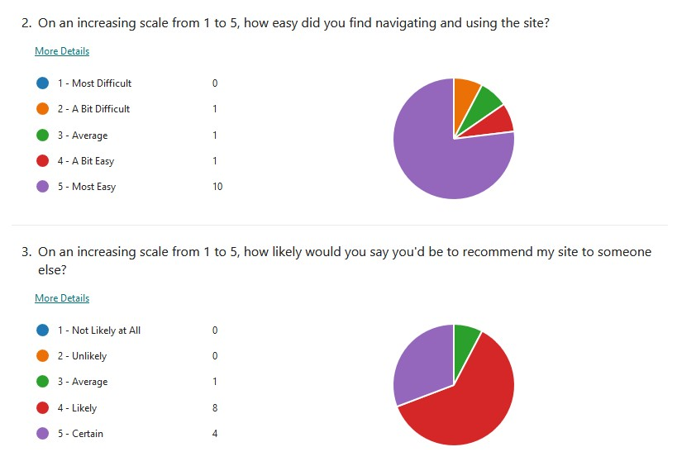
The next two questions following on from this were both ones revolving around numerical scales from 1 to 5, first about decreasing difficulties of utilizing the site and its functions and the next one being about the users’ increasing likelihoods of suggesting my site to others in turn depending on how positive their opinions of it were.
Both of these next two questions also appear to have clear majorities in terms of which particular answer was picked for each of them. Overall, these specific majority selections seem to indicate that my Beta was met with generally quite positive responses.
14 of 20

Slide 15
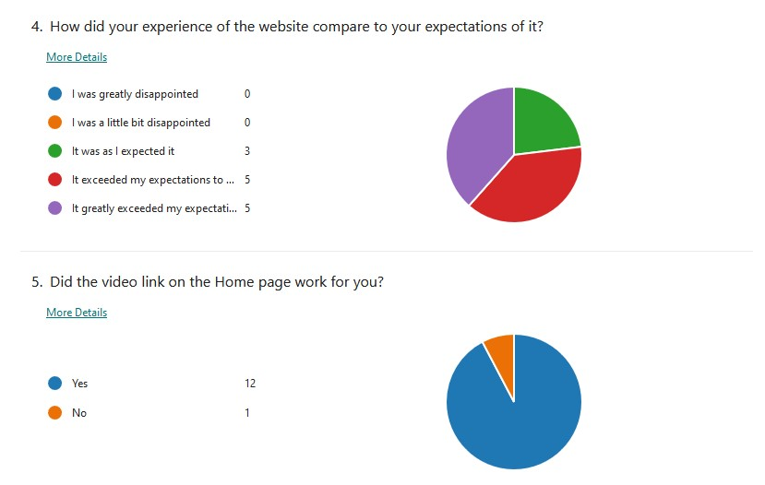
Moving on to the next pair of questions after these, there’s a pictured very clear majority answer for Question 5 whilst number 4 has a more equal weighting.
Though the one contrary given answer for number 5 is an unusual outlier of a result, it seems so far, predominantly from Question 4, that the positive general response to the Beta of my site is an ongoing trend.
15 of 20

Slide 16
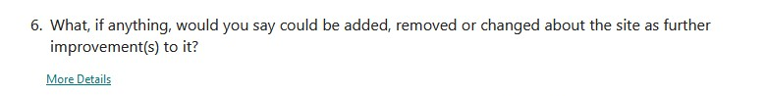
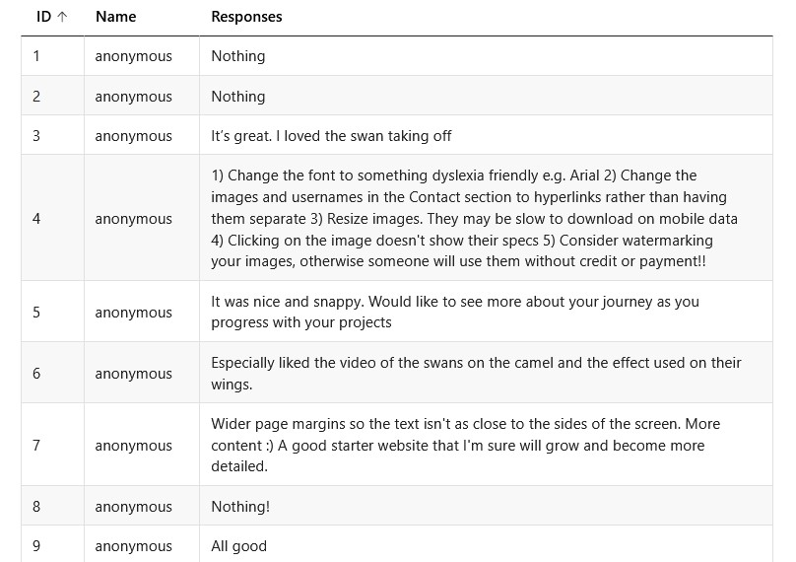
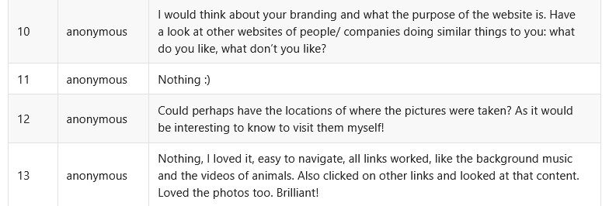
The sixth and final question of the survey, the only one which doesn’t involve multiple-choice answer options, seemingly has an almost equal weighting between suggested improvements that could be made and the site already being quite good just the way it is.
The pictured answers no. 4.4 and 12 in particular are responses that tie in with the JavaScript feature I plan on including in the website code’s final version, which would allow the user to see the locations and technical specifications of each photograph when they were taken if and when they’re clicked on, and it seems like I’ve had a positive reception to the Beta even outside of the multiple-choice questions.
16 of 20

Slide 17
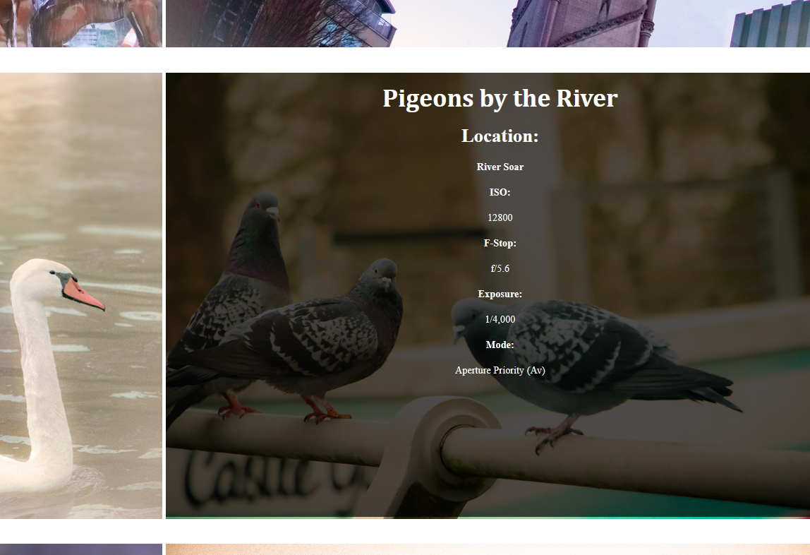
Once the remainder of the programming’s development stage was completed, I decided to add in the last-implemented feature as the finishing touch: the photographs displaying their individual locations and technical camera settings when hovered over with the mouse cursor, carrying out the act of following the previously-shown advice given via the survey in Question 6.
Although I originally intended to do this through the use of JavaScript, I ultimately opted for the HTML method instead, as the former was initially planned as working in a way where these details about the photos were only shown if and when they were clicked on; in the end, I didn’t want there to be a feel of the details being separate elements, and I wanted to ensure there was therefore more unity in the look of the page.
17 of 20

Slide 18

The technical specifications in my design concept were shown on its Raw Pictures page, underneath the images as text that you wouldn’t have necessarily been able to interact with, although this is another source of design inspiration from the previous module half that I used for my coded site, in order to make the look of the Portfolio page that little bit neater as well as adding an extra feature.
18 of 20

Slide 19
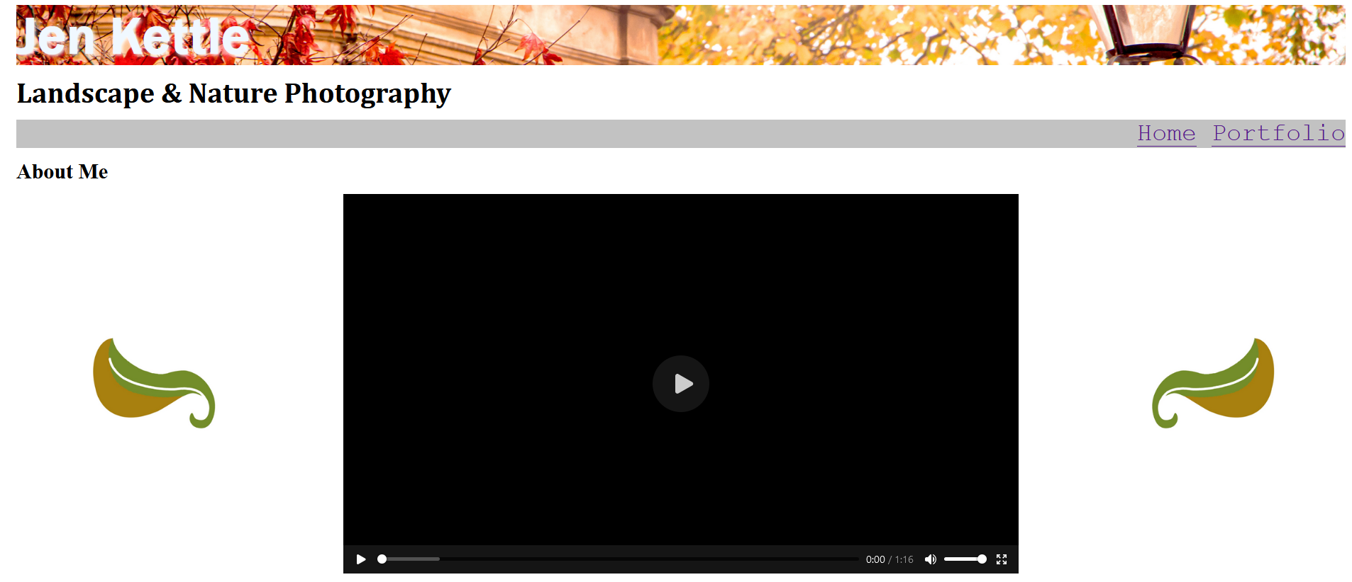
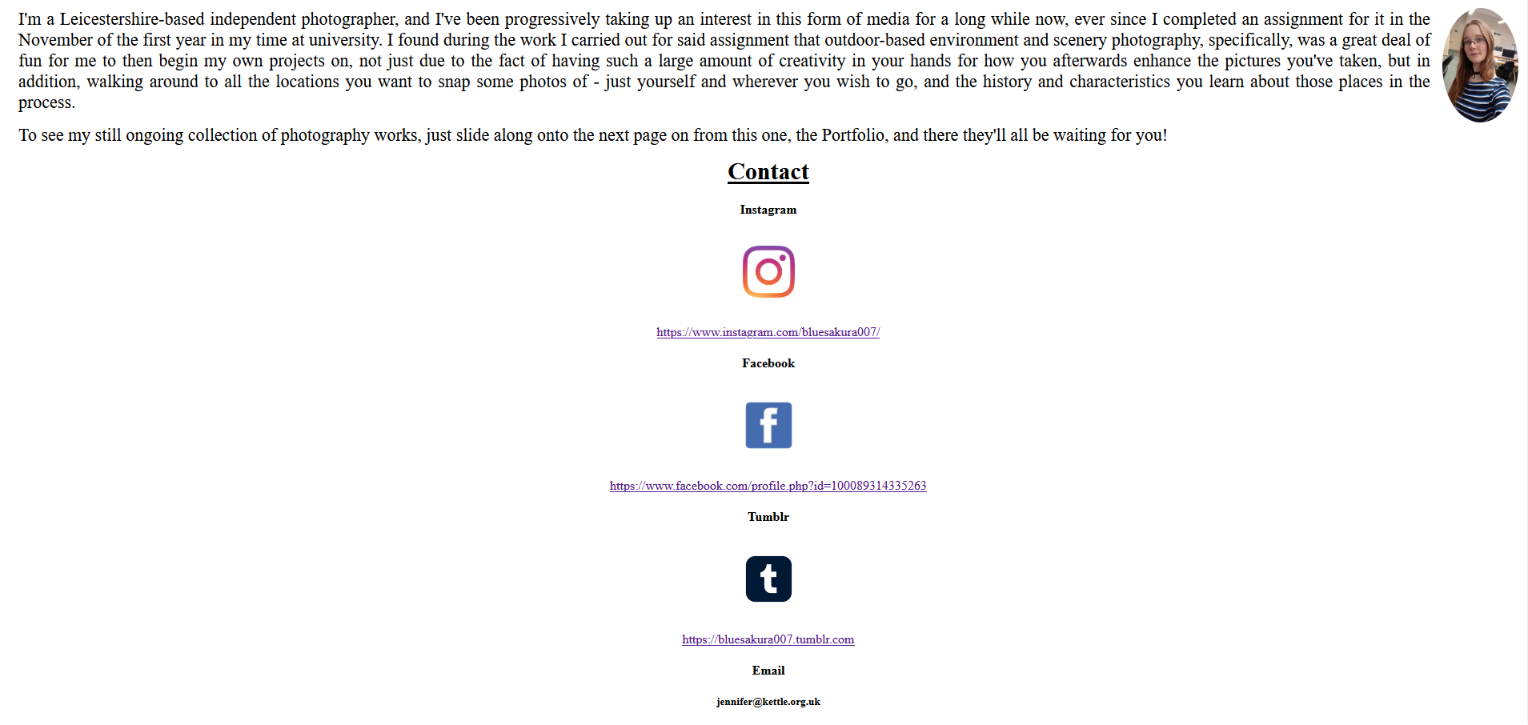
The finished result – Home page
As pictured, the main difference in this completed version from how the page looked during the earlier stages of the website’s development is that what was originally the pair of golden tildes situated on either side of where the video is located on Home have become leaves for the final version of my site, which, like their aforementioned predecessors, I also designed in Photoshop. It was my belief that these leaves would be a better choice for decoratively filling the space, because of the fact that my photography and thereby the site itself revolves around nature and outdoor scenery.
19 of 20

Slide 20
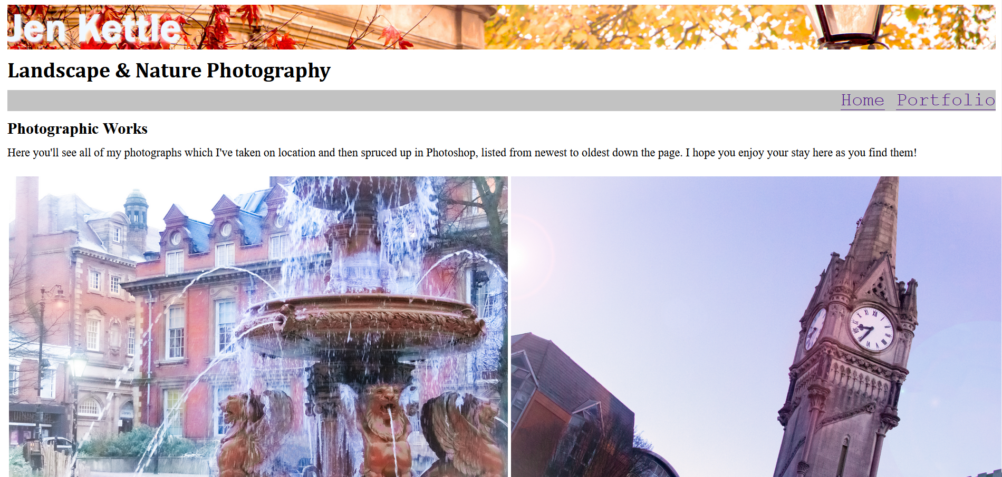
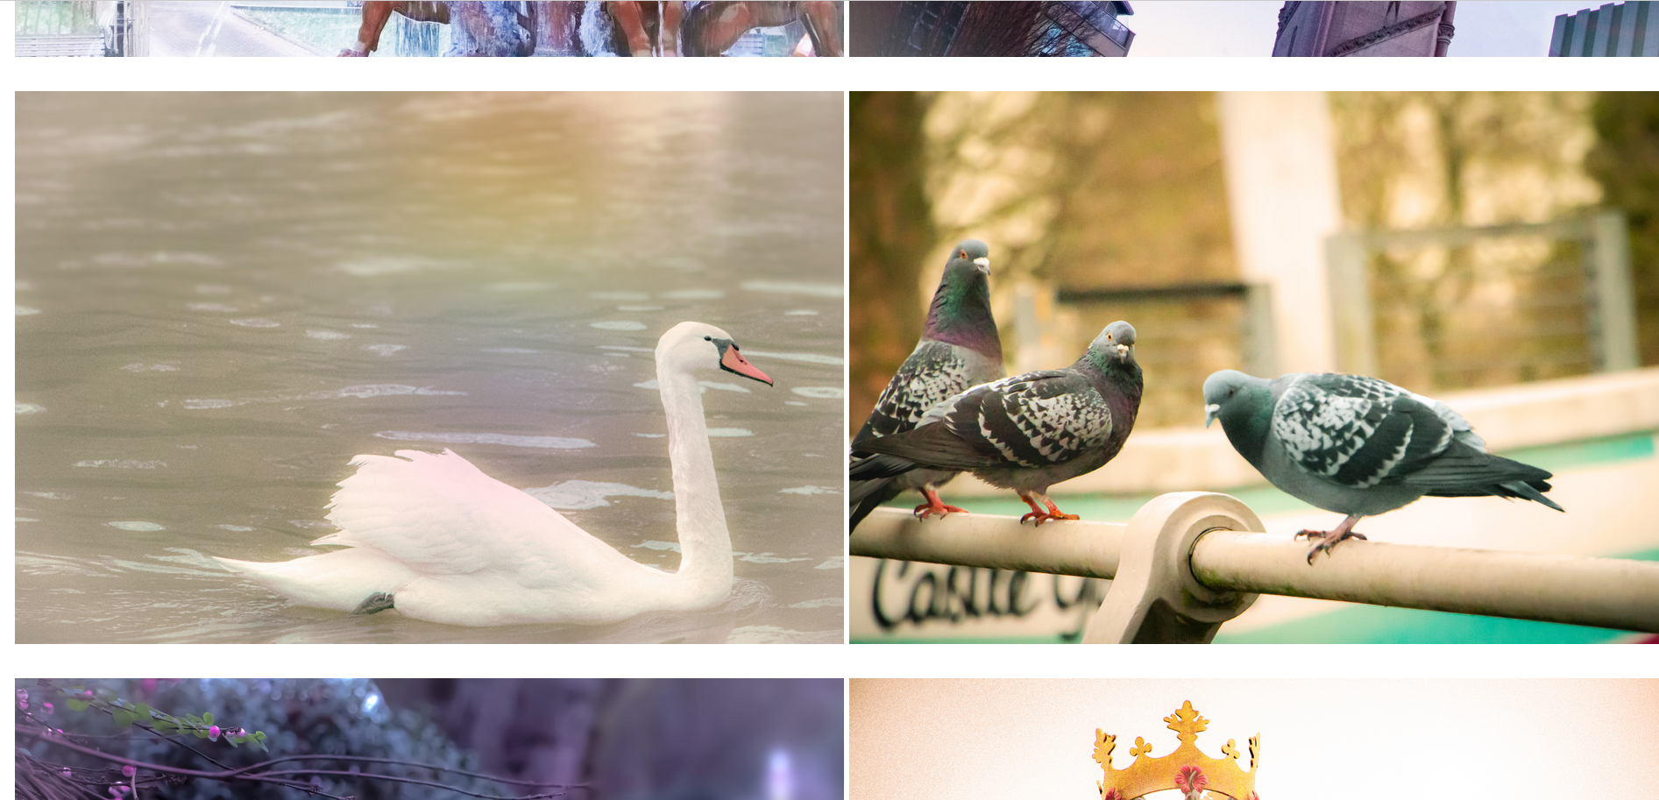
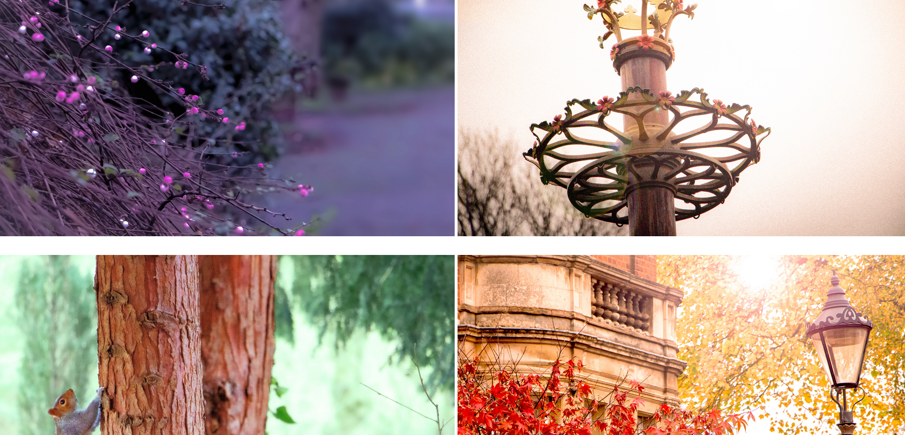
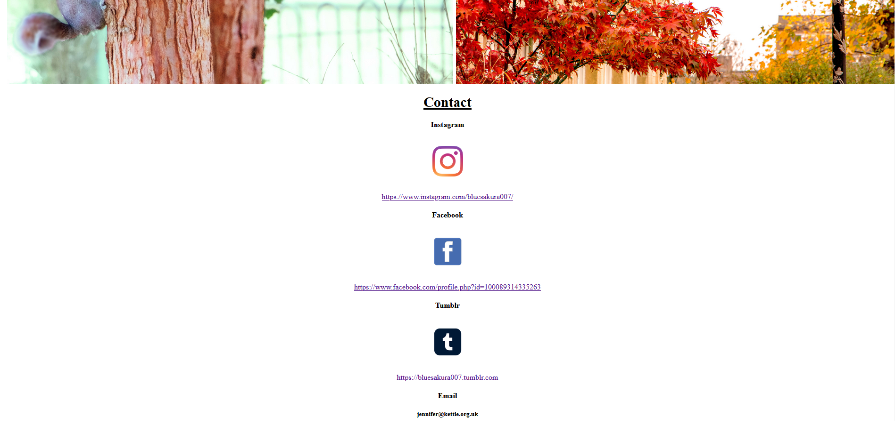
The finished result – Portfolio page
Meanwhile, on the surface level Portfolio went through comparatively less notable tweaks and changes apart from the mouse hover overlay coding that formed the feature where the photographs’ details would be displayed. I still kept slight borders between them all in order to separate them, maintaining the neatness by establishing them as separate from one another as planned.
20 of 20

